Slide 1
Empowering Breakthroughs in Pharma and Biotech
Contract Research --- Digital Health --- Real-World Data
Clinical Data Management --- Electronic Data Capture
Data Science --- Virtual Patients

Slide 2

Who we are?
..:: CRO, Masaryk University spin-off
Notes:
Our vision is HEALTHY DATA. We manage and analyze data in clinical research projects, which we also help to organize. We have developed our own solution for data collection, namely the so-called electronic-data-capture system CLADE-IS, which we will be talking a lot during today and which e.g. contains a module for risk-based monitoring based on machine learning algorithms. We were established as a spin-off of Masaryk University and we succeed in transferring the results of research and development from the academic sphere to the application in society.
Naší vizí jsou ZDRAVÁ DATA. Spravujeme a analyzujeme data v projektech klinického výzkumu, které také sami pomáháme organizovat. Vyvinuli jsme vlastní řešení pro sběr dat, a to tzv. electronic-data-capture systém CLADE-IS, který mj. obsahuje modul pro risk-based monitoring založený na algoritmech strojového učení. Vznikli jsme jako spin-off Masarykovy univerzity a daří se nám přenášet výsledky výzkumu a vývoje z akademické sféry do aplikace ve společnosti.

Slide 3
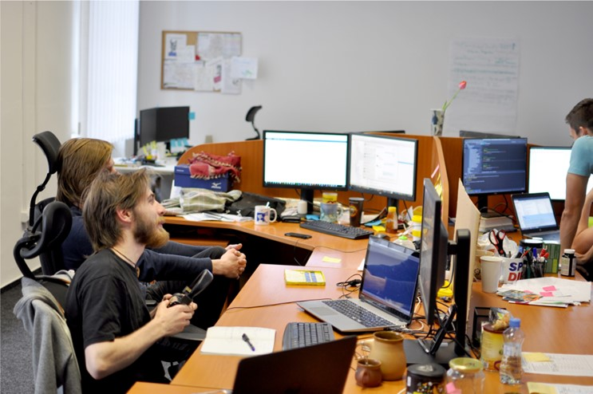


Projects beyond clinical trials
..:: SW development
SW house ?...
…well-recognized CRO!
Notes:
We are a CRO providing full services in clinical research projects.
With our >15 years on the market, we have become a well-recognized CRO, also thanks to some networks and infrastructures… Today, we are proud to be certified data centres in…
EHDEN stands for a pan-European initiative for gathering and exploiting data from patient registries and non-interventional clinical studies.
ECRIN – European Clinical Research Infrastructure - is a public, non-profit organisation that facilitate multinational clinical research, mainly intiated from academia.
NON-INTERVENTIONAL CLINICAL STUDIES

Slide 4
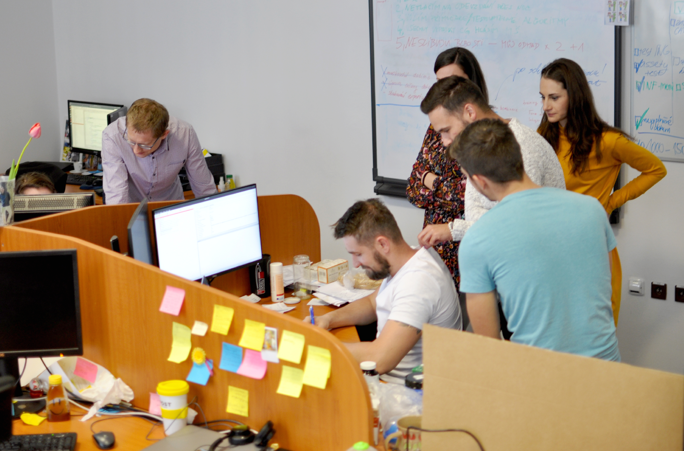
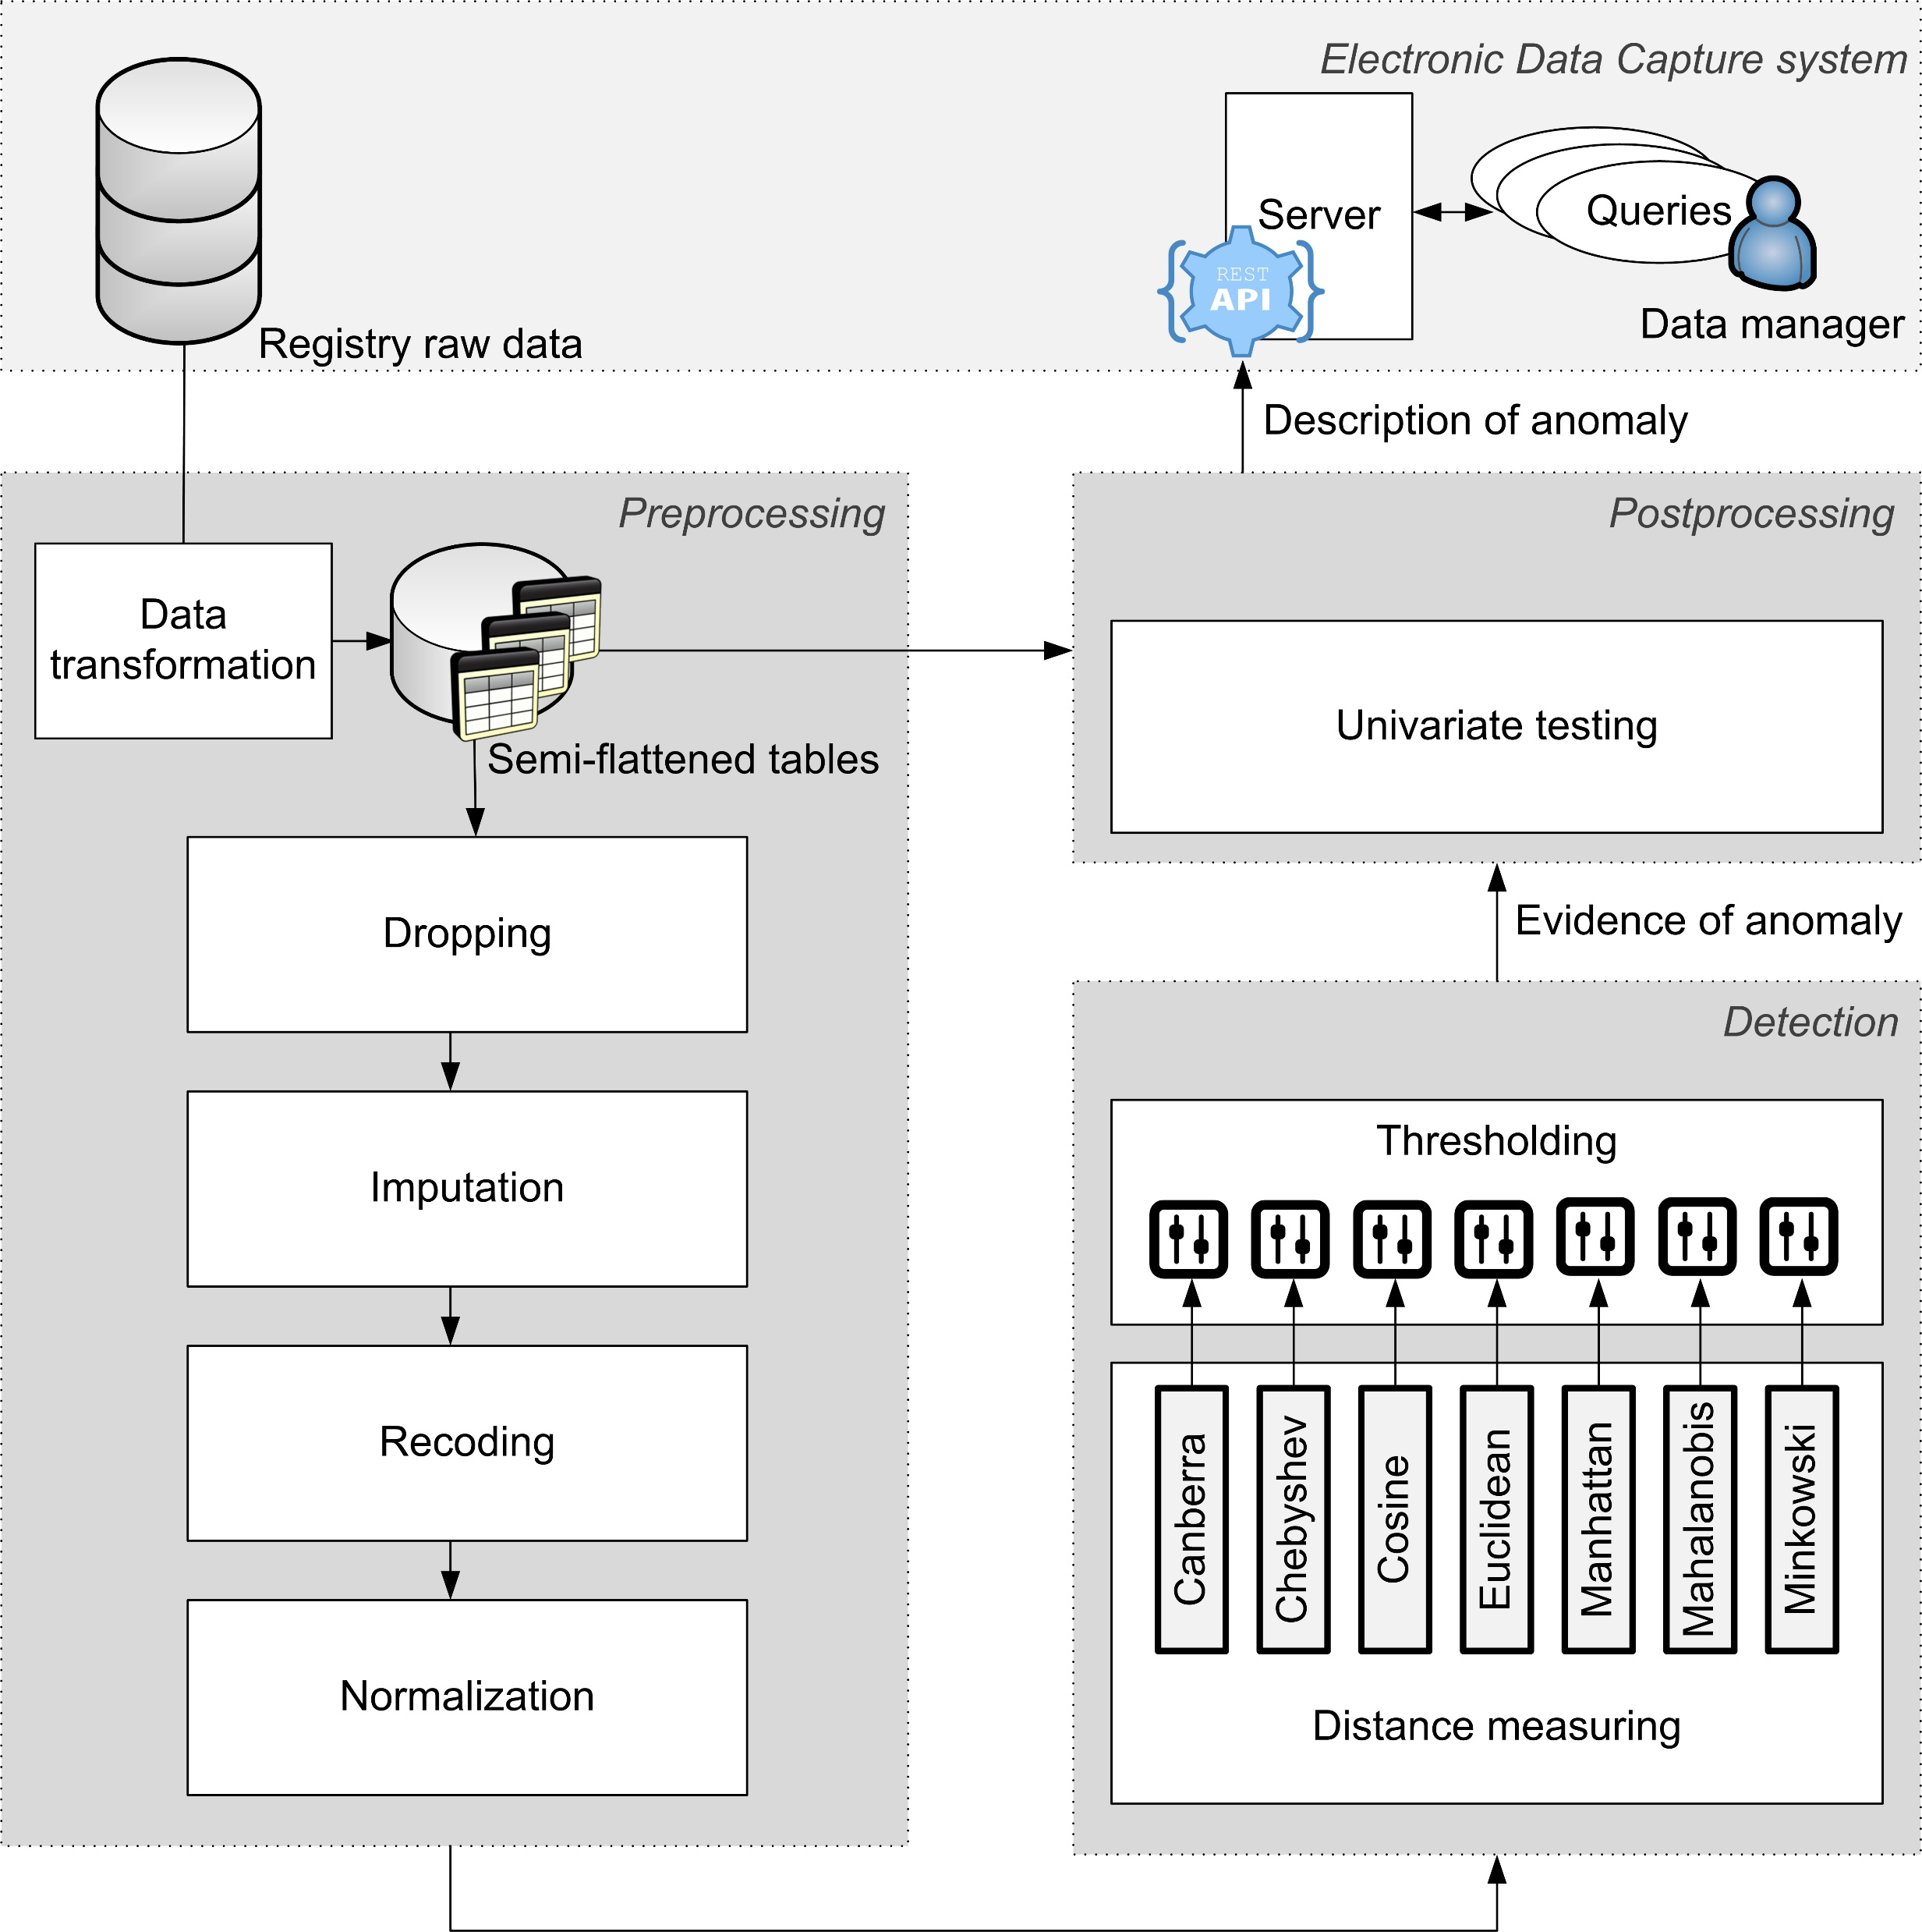

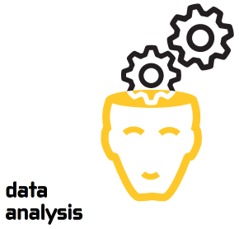






Kdo jsme?
..:: CRO, spin-off Masarykovy univerzity
data
management
data
analysis
information
technologies
project
management
Notes:
Our team consists of approximately 50 people and we are divided into four main departments...
1---Our data analysts/biostatisticians perform insightful data analysis for better decision making - I mean decision making for pharmaceutical companies, biotech companies, research scientists.
2---We have our own R&D department with several software developers and data scientists whose goal is to innovate IT solutions for intuitive and secure use
3---Our data managers provide reliable clinical data management services in healthcare and life sciences, their purpose is to ensure data integrity and to supply analysts with reliable validated data from which they then draw some conclusions.
4---relationships with our researchers as well as sponsors and also with regulatory bodies is handled by the PM department.

Slide 5
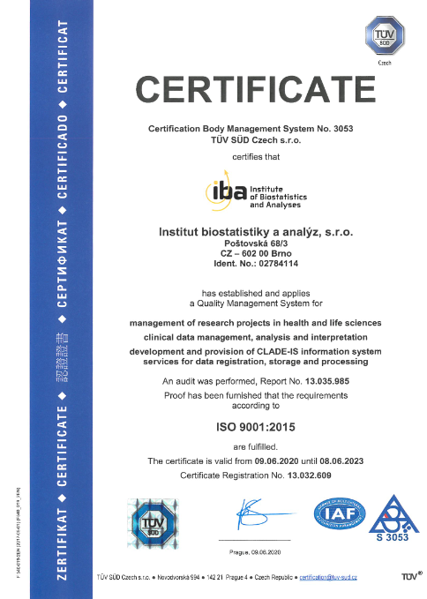
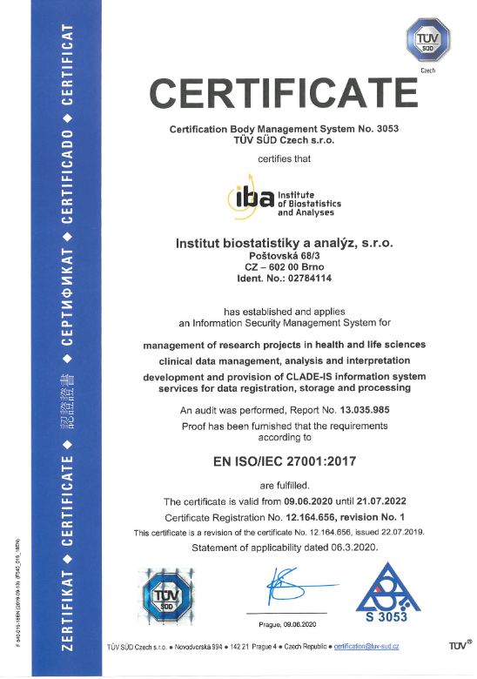

Quality and regulation play a role !
Notes:
In addition to software production, we have also been dealing with the great importance of regulations, data protection and compliance with recommendations & good practices.
Unlike typical startups, we are a seasoned SME with over 15 years of market presence, fortified by ISO 9001 and ISO 27001 certifications, offering hospitals and CROs proven, high-quality solutions.

Slide 6
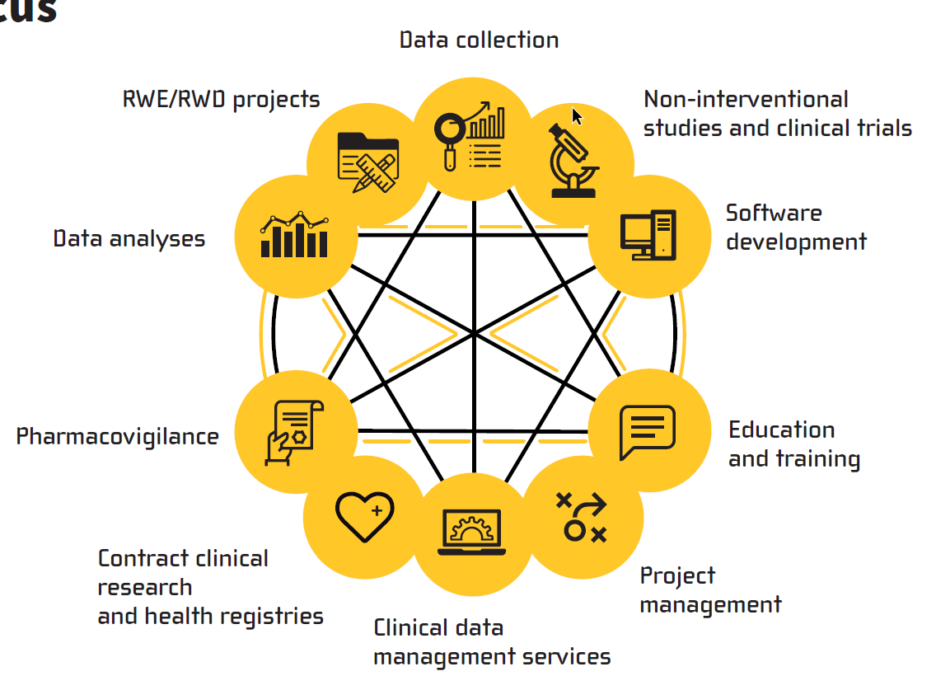
Streamlined Services for Business Excellence
…Discover the possibilities!
Notes:
In addition to software production, we have also been dealing with the great importance of regulations, data protection and compliance with recommendations & good practices.

Slide 7
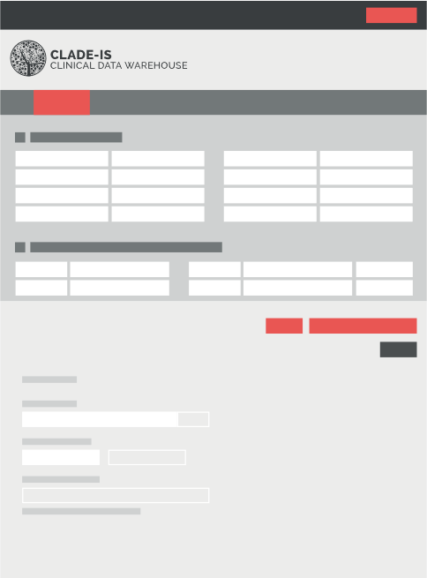
Electronic Data Capture
Clinical Data Management platform
Notes:
CRO => EDC

Slide 8
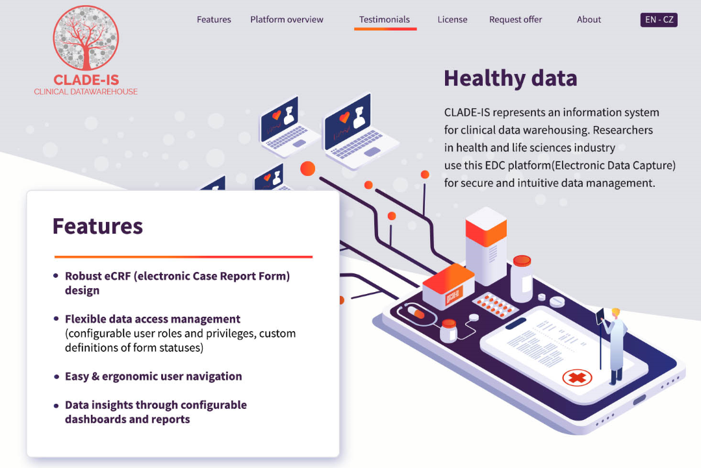
Notes:
I am sure that for everyone here it is well-known that electronic data capture (EDC) systems have recently proved to be a more efficient and also a cheaper alternative to the paper data capture. EDC systems enable investigators to enter data directly into electronic case report forms (eCRF) and also enable the study coordinators to oversee and control the trials in real time even in multicenter research studies.
The CLADE-IS system, which is in fact an in-house-developed system by IBA. And it is also the system employed in our clinical research projects. The name CLADE-IS stands for CLINICAL DATA WAREHOUSING INFORMATION SYSTEM.

Slide 9
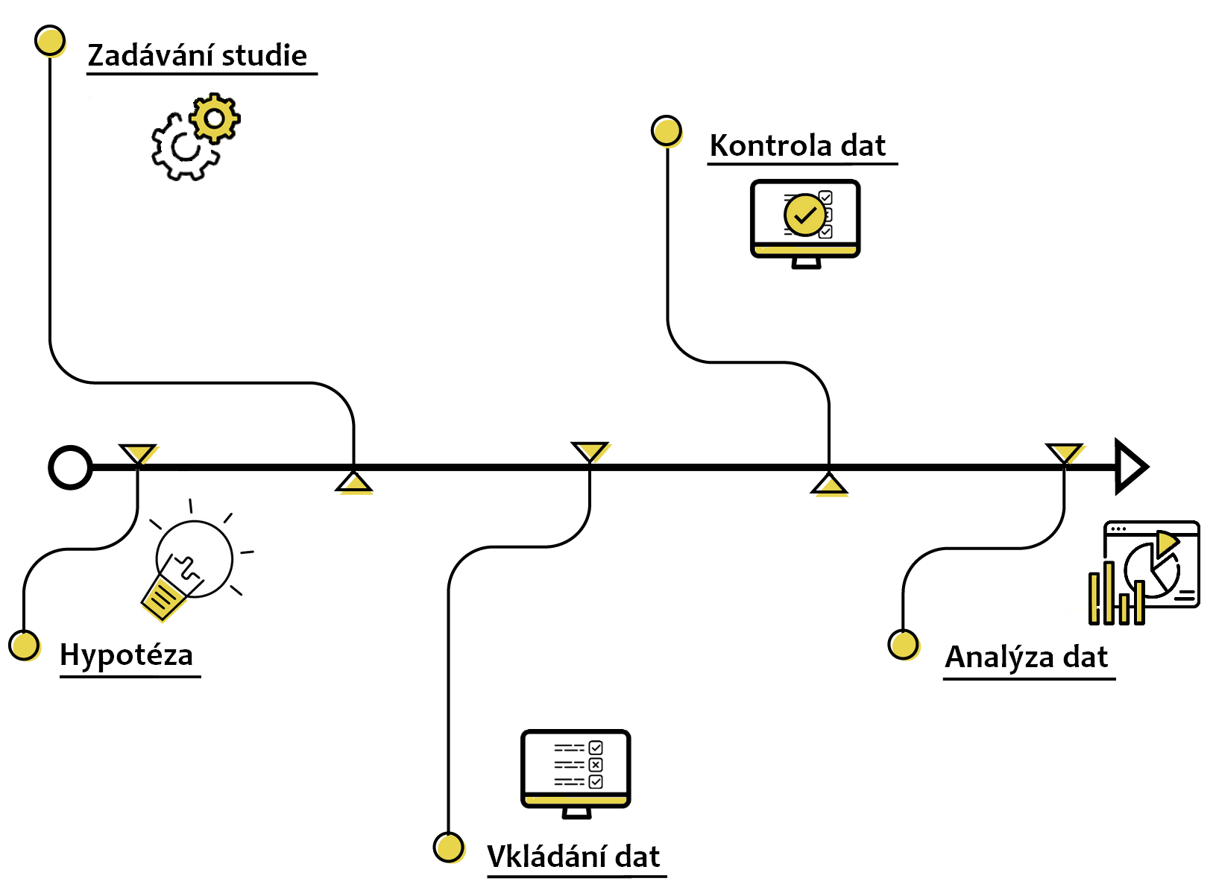

From a hypothesis to an outcome
Study design
Data validation
Hypothesis
Data analysis
Data entry

Slide 10
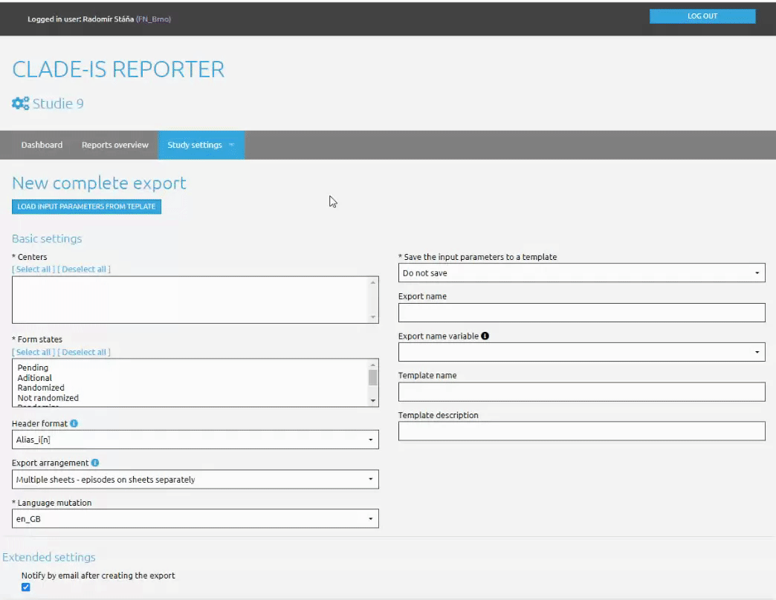

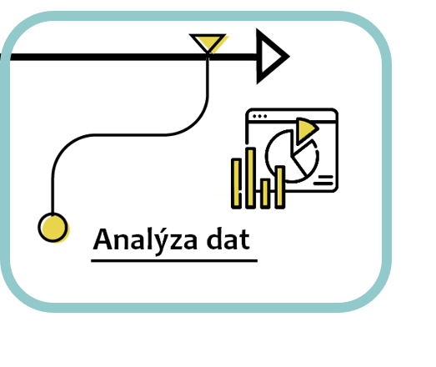
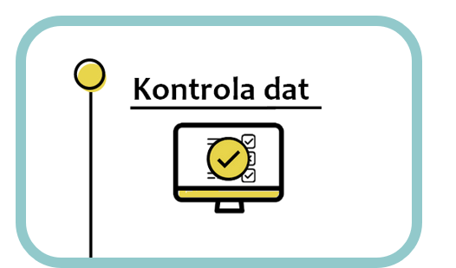
Toolkit for data analysis
Export
Who: Analyst
Where: Reporter
Data analysis

Slide 11
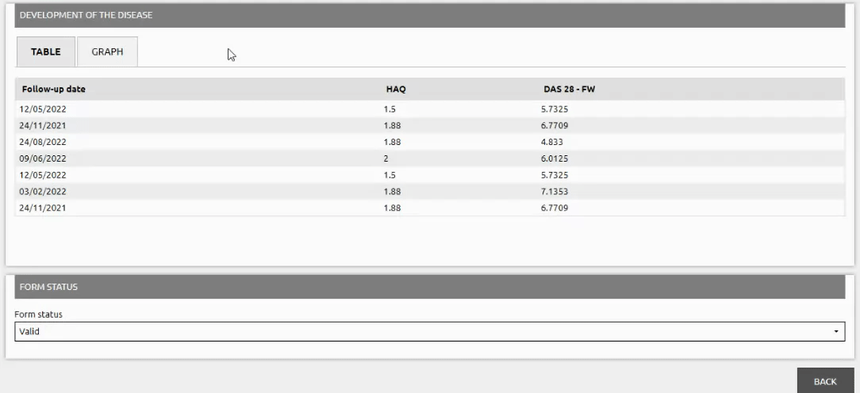

Toolkit for data analysis
On-line vizualization
Who: Healthcare professional
Where: Study
Data analysis

Slide 12
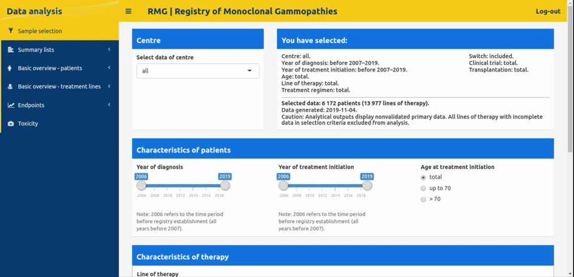
Toolkit for data analysis
Visual analytics on a project website
Who: Biostatistician
Where: Ext. website
Data analysis

Slide 13
From a hypothesis to an outcome
Study design
Data validation
Hypothesis
Data analysis
Data entry

Slide 14

3D printing in medicine
product life cycle management
Notes:
Software for product life-cycle management in 3D printing medical applications

Slide 15
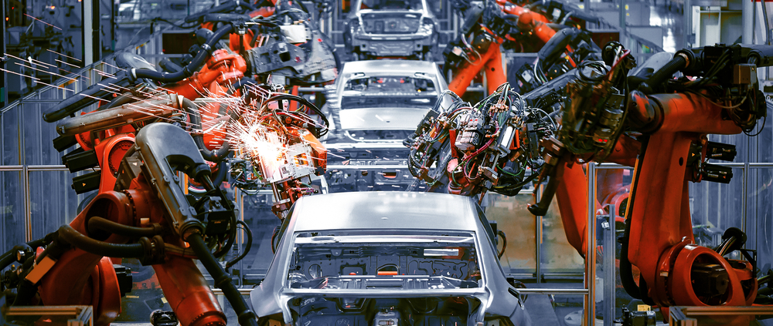
The problem we are solving
Lack of QM/DM system for parts production...
Notes:
Lack/Missing!

Slide 16
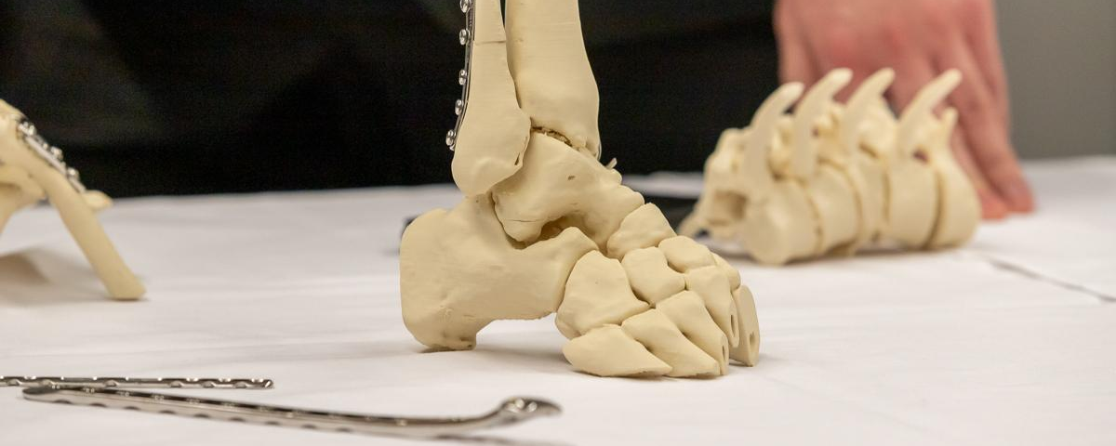
The problem we are solving
Lack of QM/DM system for parts production...

Slide 17
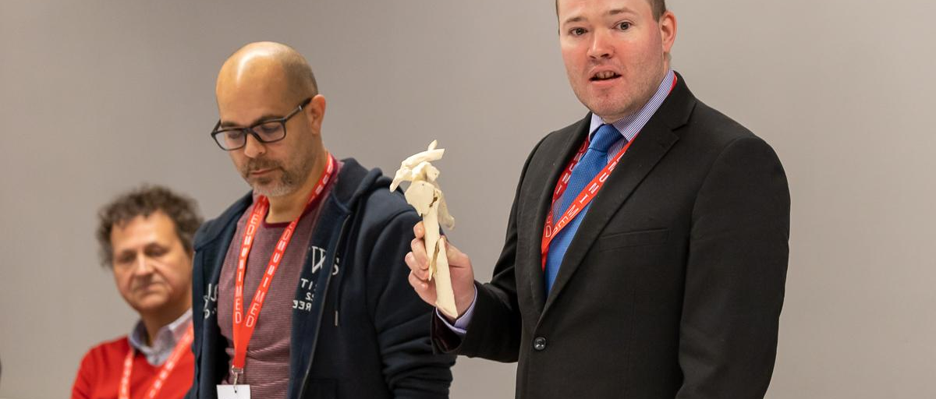
The problem we are solving
Lack of QM/DM system for parts production...

Slide 18
Quality management for 3-D print
Centre: calibration = printing the model and measuring it; geometry verification
Case: approval process, e-signatures
Three levels of 3D print:
anatomical models - for preoperative planning - not for the operating room,
no sterility is addressed
resection templates - saving operative time - sterilization
and material type are addressed
implants - different materials and different printers (SLA) and easier sterilization; medical device.

Slide 19

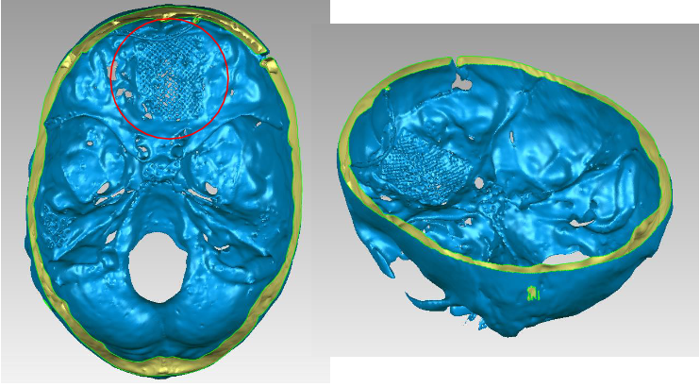
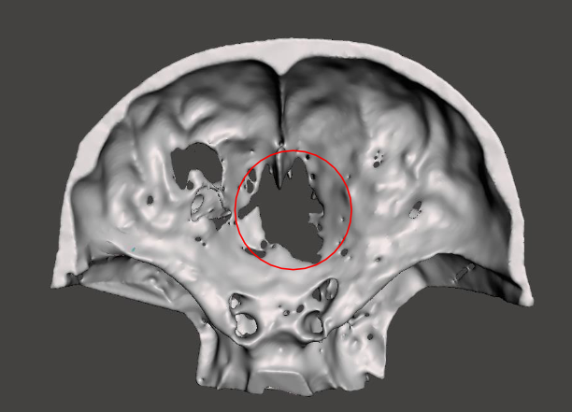
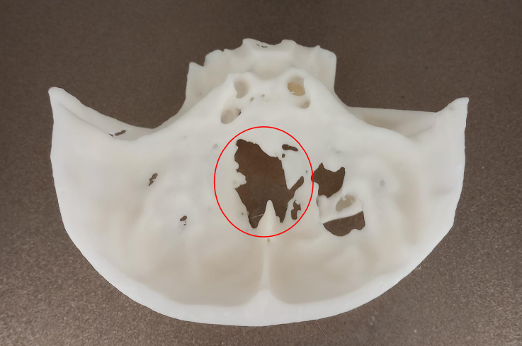
Case reports (1/2)

Slide 20
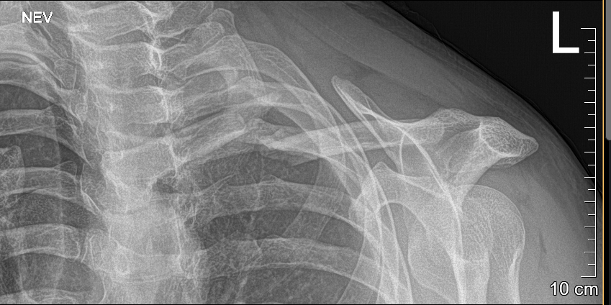
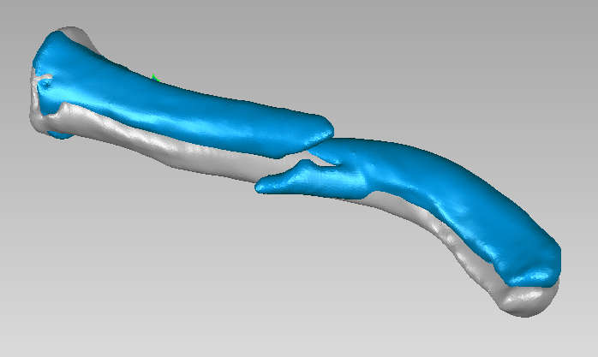
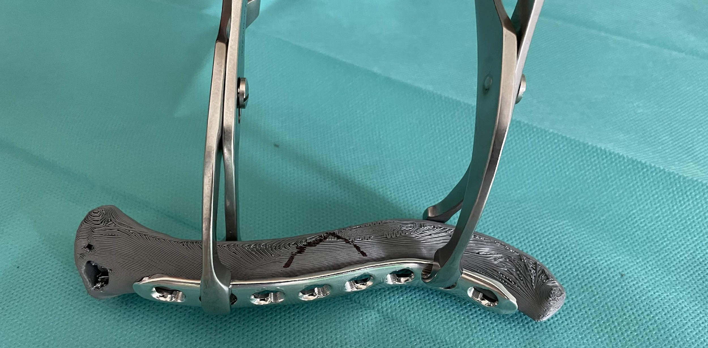
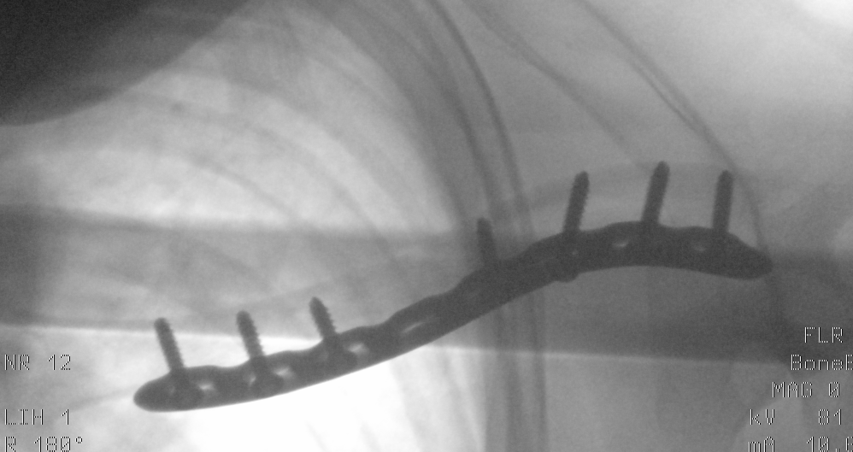
Case reports (2/2)

Slide 21
Problem entities
Patient, mannequin
Virtual model
  imaging data
  STL model
Approval process
  clinician
  engineer
Hospital, clinical site
External customer
Technological documentation
of the model
  material
  video
  etc.
Documentation of the surgery
  photo (bending, etc.)
  etc.
Notes:
We identified these entities for which we needed to find a suitable data description.

Slide 22
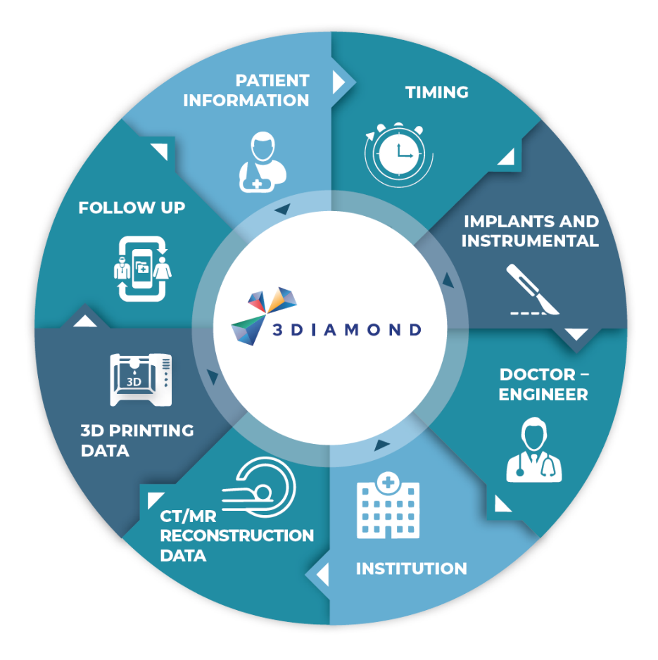
PLM for 3D printing medical applications
Quality manager
Physician
Clinical Engineer
Notes:
We considered from the beginning three use-cases : clinical engineer, physician and quality manager

Slide 23







www.biostatistika.cz | www.clade-is.com
schwarz@biostatistika.cz
https://www.linkedin.com/in/daniel-schwarz-197706/
https://ibapodcast.podbean.com/

