Slide 2
grave problem
CRC
Colorectal Cancer

Slide 3
Second
biggest cancer
killer
CRC is the second deadliest
cancer worldwide

Slide 4


Every
3 minutes
One European dies
of colorectal cancer

Slide 5
Even an experienced
doctor misses 20% of adenomas (ADR)¹
Adenomas are what CRC arises from.
1. Lee A, Iskander JM, Gupta N, et al. Queue position in the endoscopic schedule impacts effectiveness of colonoscopy. Am J Gastroenterol. 2011 Aug; 106(8): 1457-1465.

Slide 6

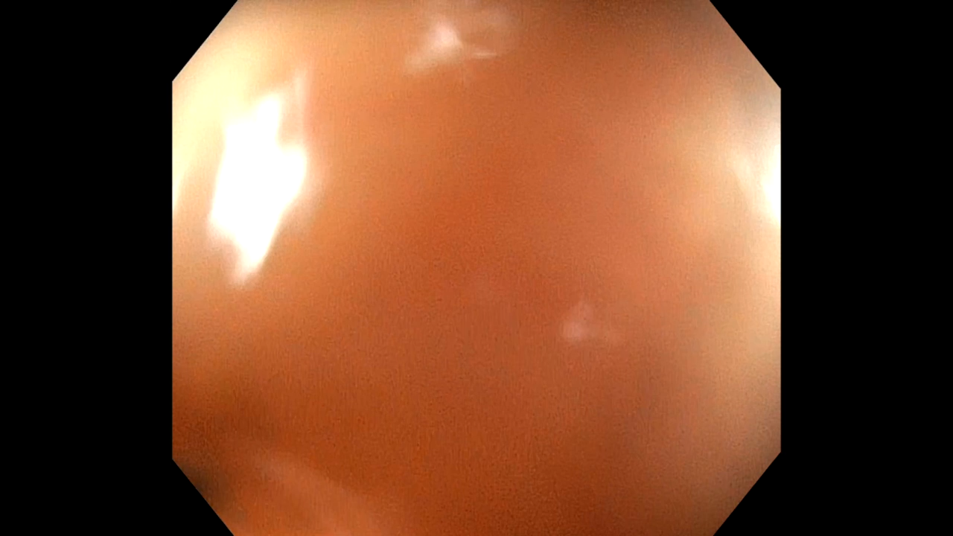
Sometimes it's impossible for human to see adenomas
1% increase in ADR reduces cancer risk by 3%
Corley DA, Jenson CD, Marks AR JR, et al. Adenoma detection rate and risk of colorectal cancer and death. The New England Journal of Medicine. 2014; 370: 2539-2541.

Slide 7
Where eyes cannot see, technology can

Slide 8
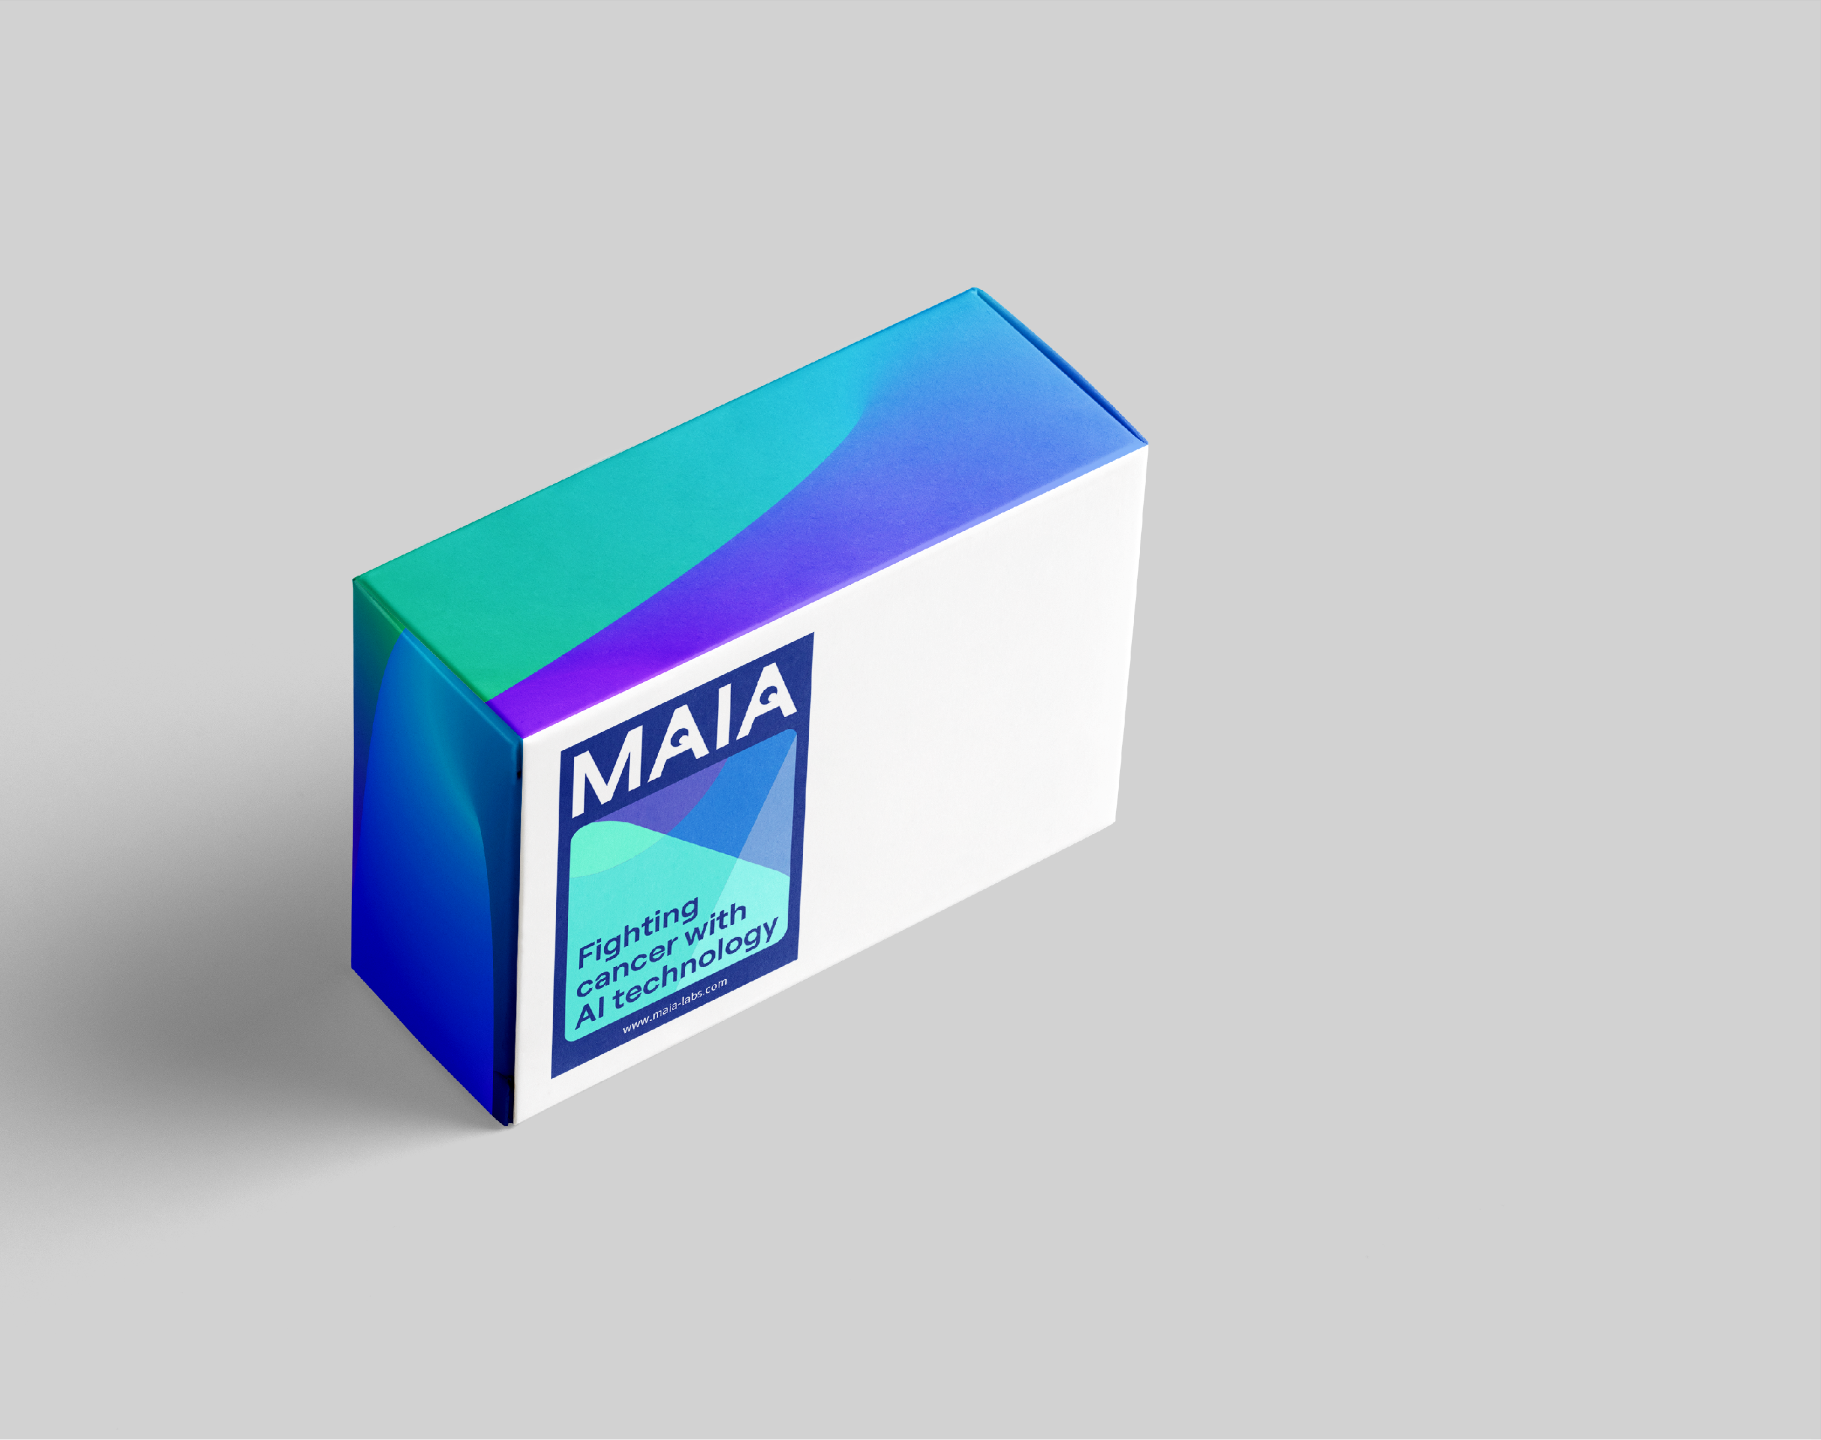
MAIA is intelligent endoscopy module
Based on state of the art AI technology

Slide 9
Increases
Adenoma Detection Rate (ADR)
Speeds up the examination by up to 20%

Slide 10
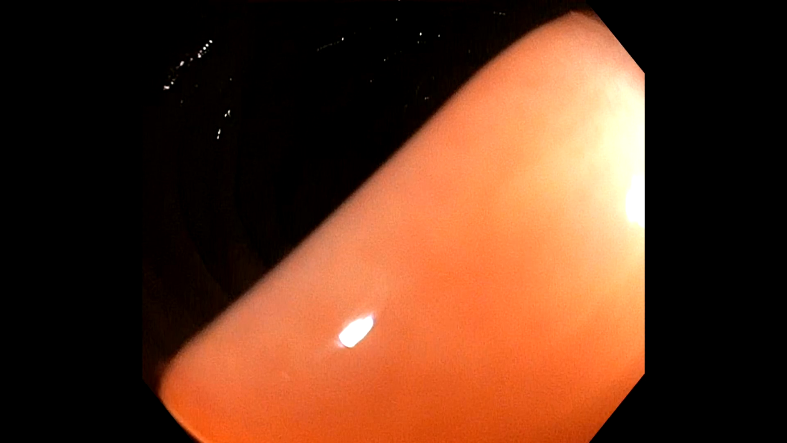
A real demonstration of MAIA

Slide 11
Detection
Classification
Measurement
Medical report
Detection
of lesions
and polyps in
real time
Classification
of findings
Optical histology
Automatic measurement
of polyps and lesions
Final report including size, type and picture of findings

Slide 12
HW Enables
Acquire Datasets

Slide 13
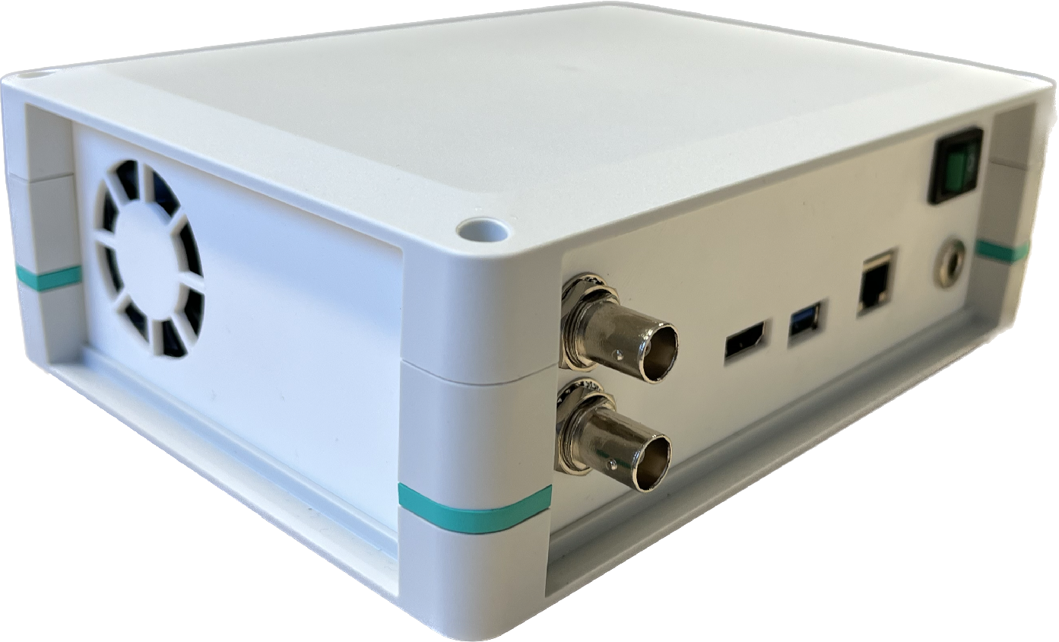
MAIA-box is based on the architecture of AI modules in cars

Slide 14
4×
More powerful than MacBook Pro M1
10×
Lower consumption than similarly powerful solutions

Slide 15
Compatible With All Endoscopes
Installed in 10 minutes

Slide 16
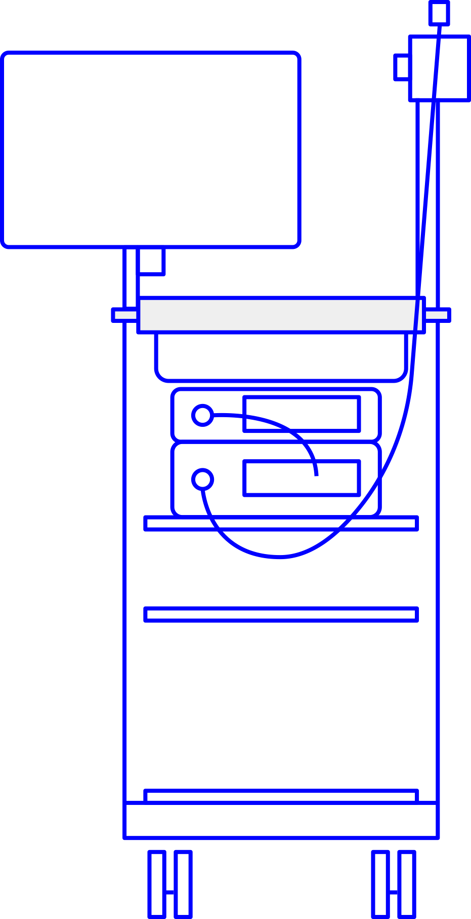


MAIA-box can
be installed to any endoscope on
the market.
And it does not affect the operation and warranty of the endoscope.

Slide 17
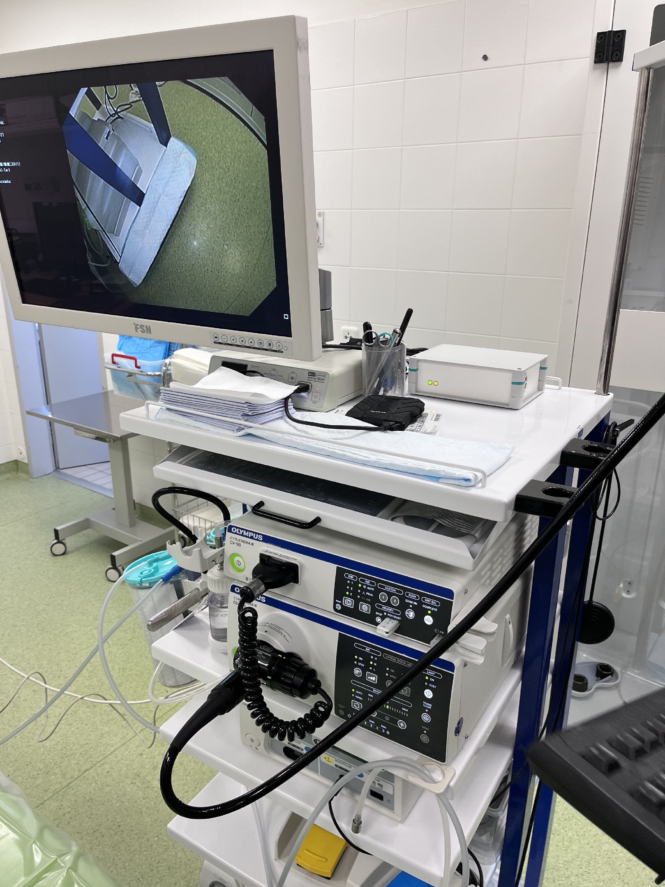
MAIA installed in the hospital

Slide 18
Products

Slide 19

Smart Recorder
Transform your video quality to the next level with real-time video enhancement, making it look like it's in 4K resolution!
Auto start/stop recording
AI Video enhancement
  Higher quality of video picture
  Increasing the legibility of structures
Recordings in higher quality and smaller file sizes
  AI Content adaptive bitrate
Video streaming and Video archive
Detection and removal time of the CECUM
Tool detection
ADR - Adenoma Detection Rate
Statistics and regular reports
Starting from 250 EUR/month

Slide 20
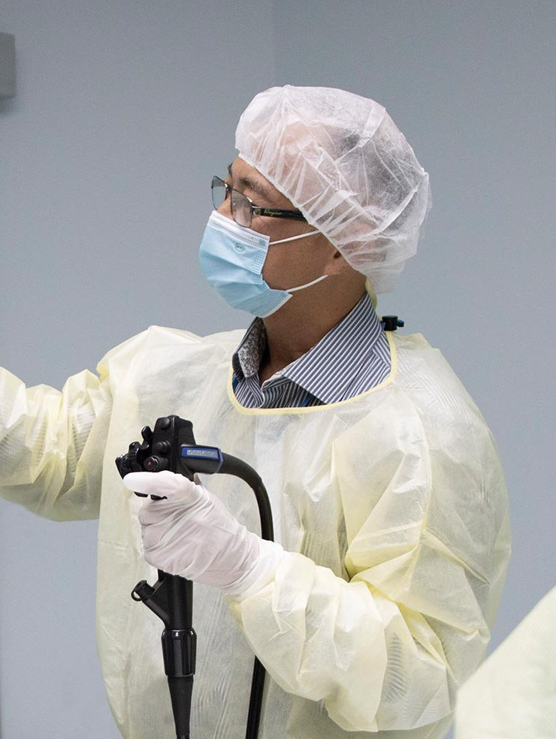





AI Assistant
MAIA improves the quality of the examination and reduces the risk of missed findings. Saves 20% of the doctor's time!
Smart Recorder functions included
Adenoma
  Detection
  Classification
  Size Measurement
IBD scoring
  Classification
  Size Measurement
BBPS scoring
Generate a medical report
Starting from 650 EUR/month

Slide 21
2023
Every two weeks we install one MAIA-box
2024
Certification will be completed
2025
Launch of further modules that will multiply profits

Slide 22
We work with
Czech Society of Gastroenterology
with almost all university hospitals in CZ
and several private hospitals CZ & SK
We already have 7 paid pilots in hospitals

Slide 23
Who are we?
The experienced team behind successful AI applications for transportation and industry.
We want to bring modern and proven technologies from industry to healthcare.

Slide 24
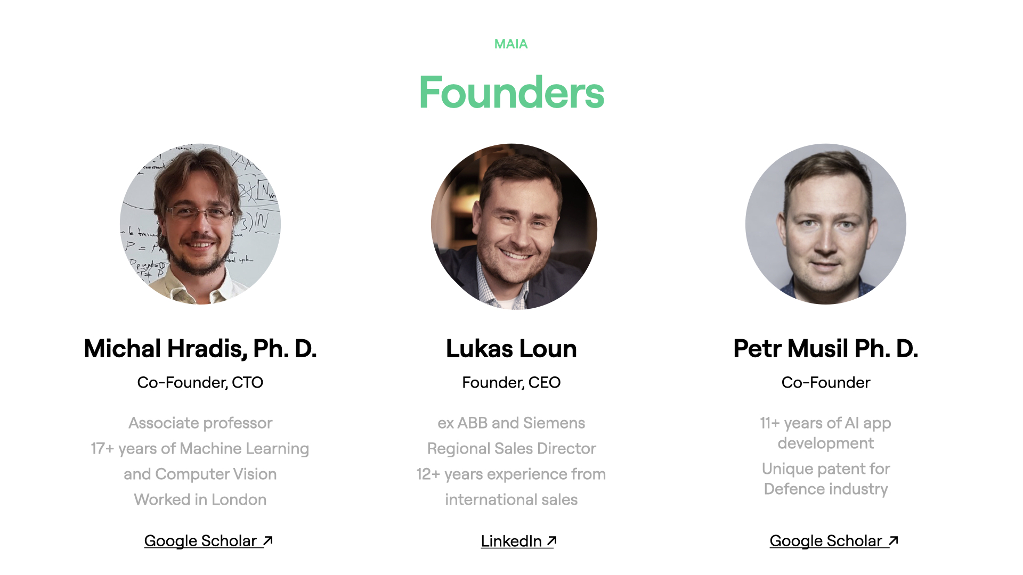

Slide 25


Slide 26

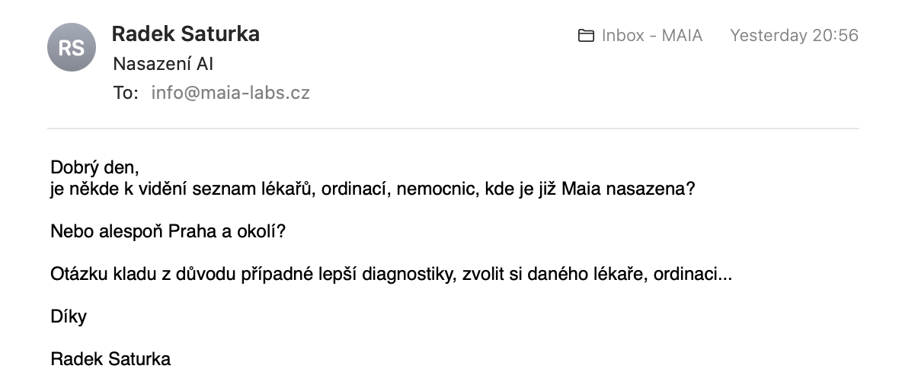
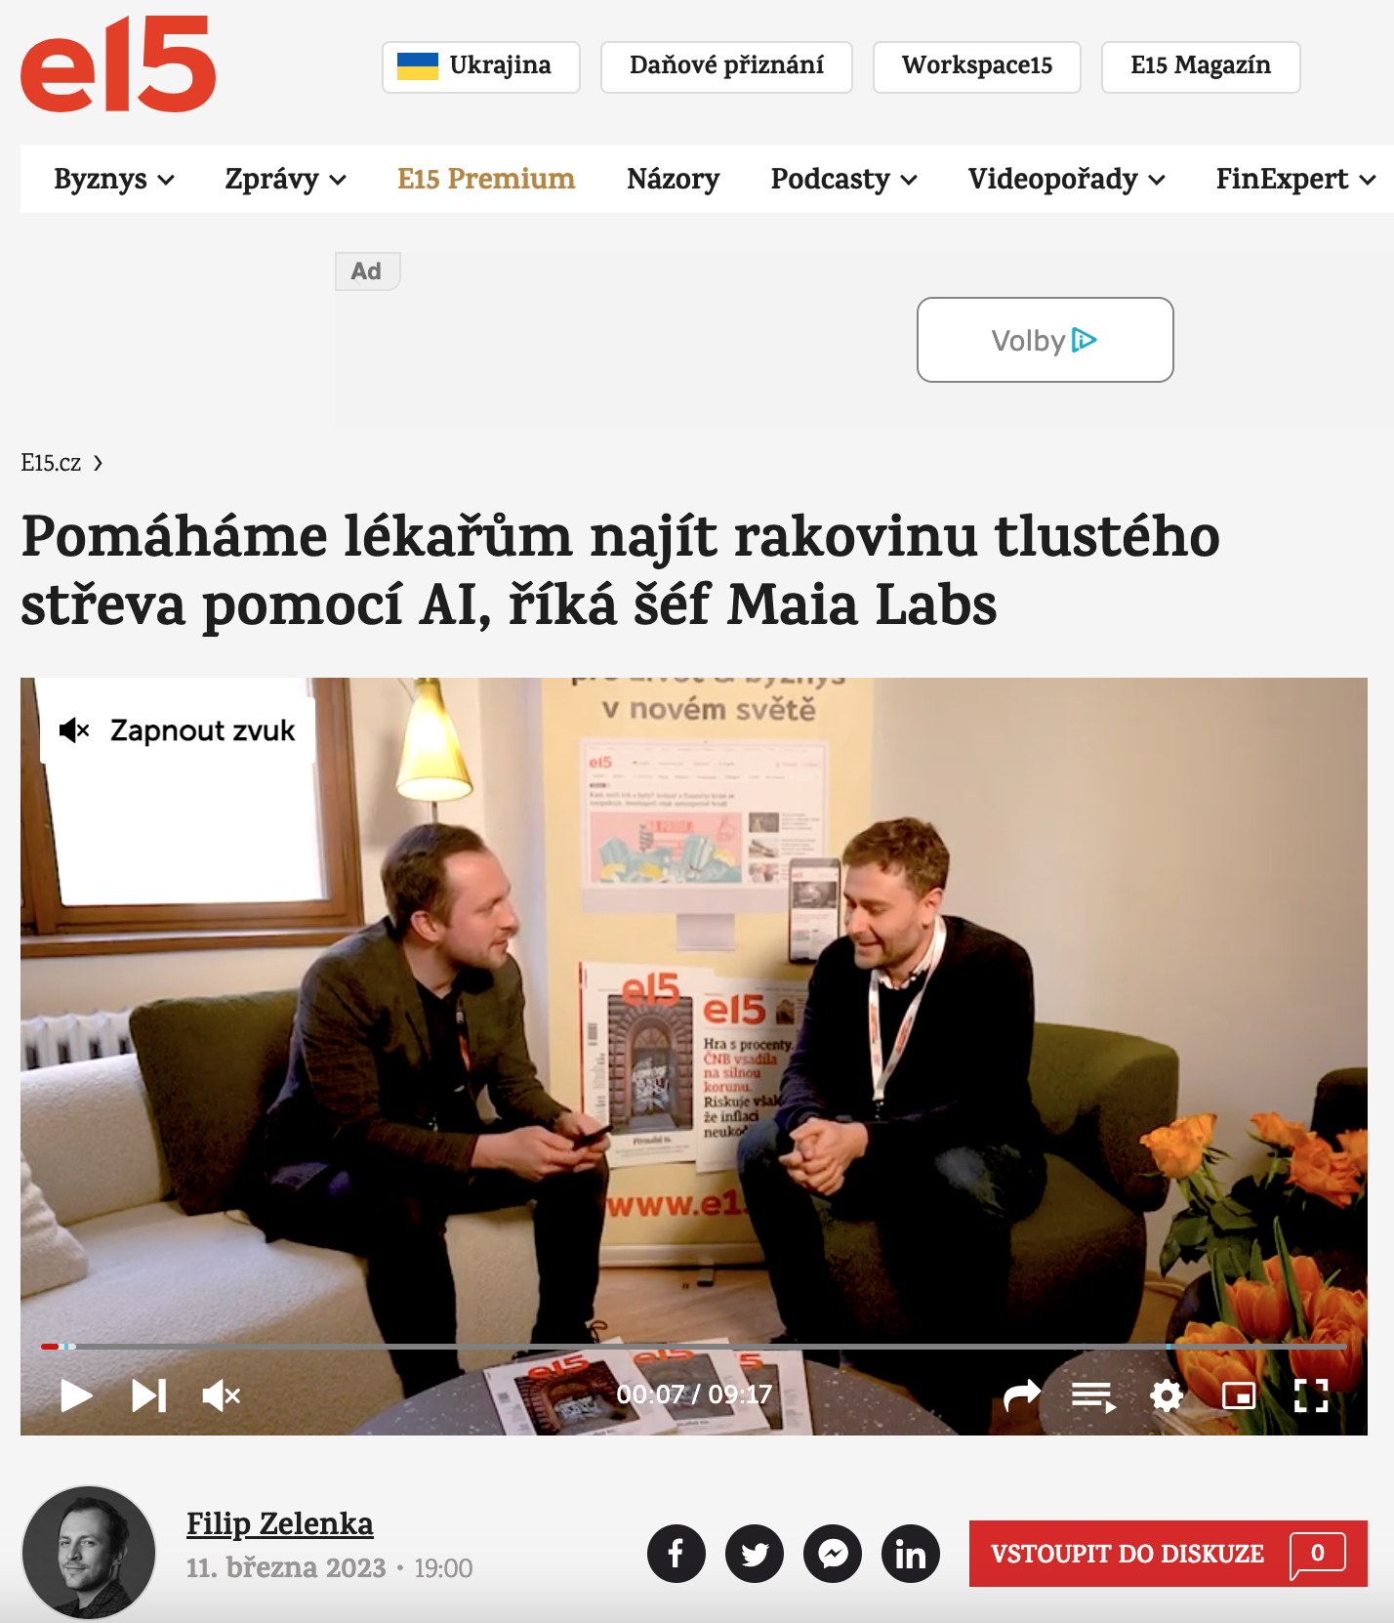
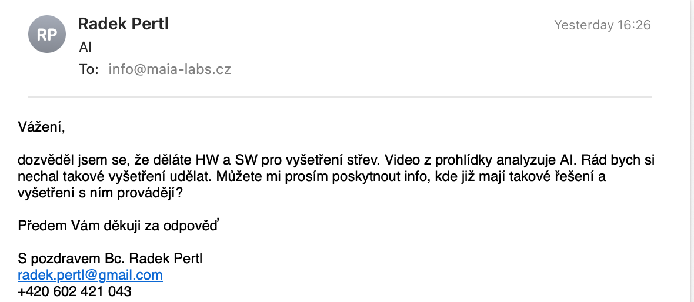
MAIA v médiích
Reakce veřejnosti

Slide 27
AI Technology

Slide 28
MAIA annotator
Web based app
Much faster annotation
Active learning
Tracking objects
Interactive segmentation
Learning mode for doctors and medics

Slide 29
Technologies
Video-native processing
Video detection models
Dense motion tracking (Optical flow)
3D reconstruction
Motion blur compensation
Multi-frame composition
High Dynamic Range (HDR)
Multi-band imaging and composition
Super-resolution and denoising

Slide 30

We developed video annotator
for medical purposes
Algorithm with greater accuracy and faster learning than other image-based systems
Learning from medical reports
and videos without a human being present
Other medical fields use endoscopy

Slide 31


